Slide 1
Acknowledgement Internet Images, available in Public Domain, have been used in many Slides of this Presentation. Some of the Images have also been Modified/Superimposed. Used only for Academic Purpose/Understanding.
Lecture-9
Takeaways :
Casting Dynamical Systems in the State Space Framework
Transfer Function to State Space & State Space to Transfer Function
Solution of the State Equation
The State Transition Matrix

Slide 2
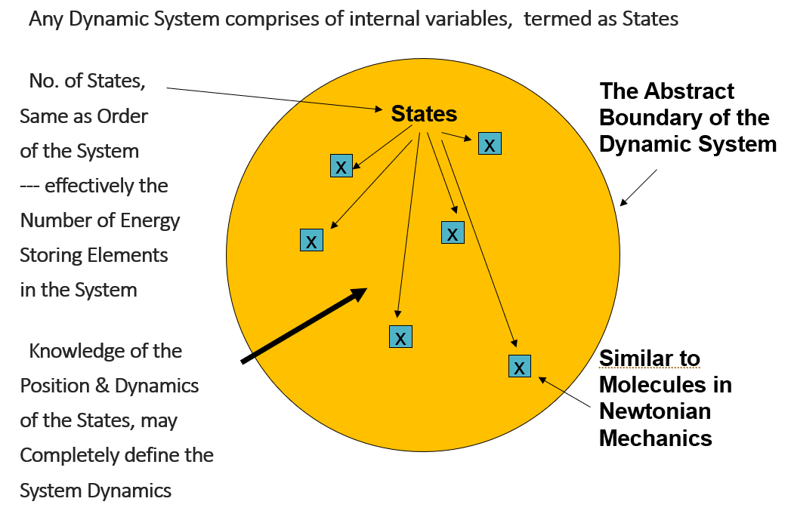
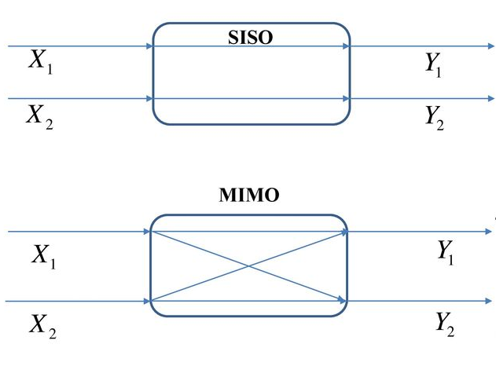
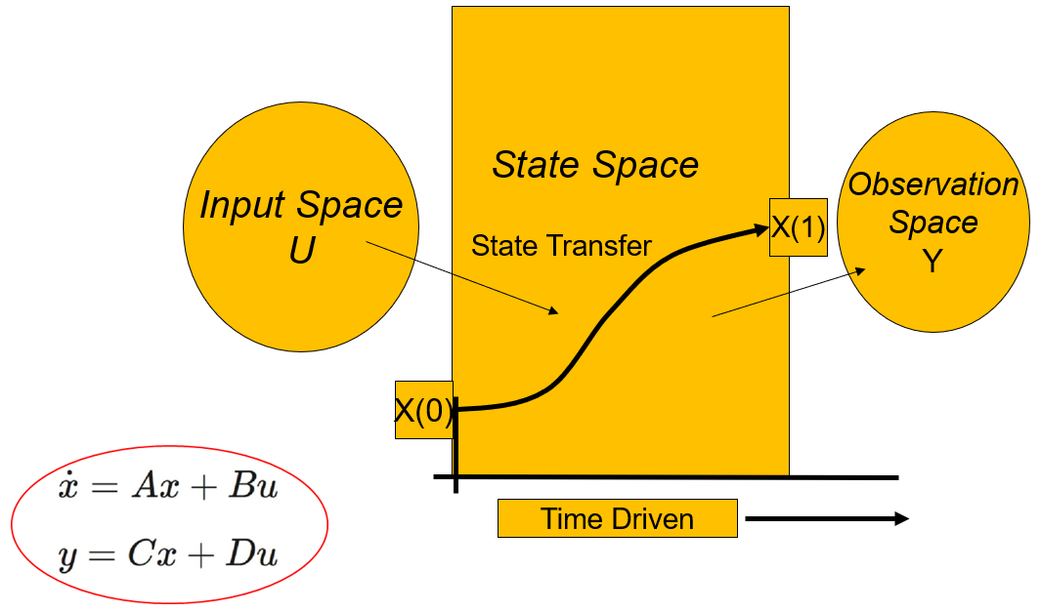
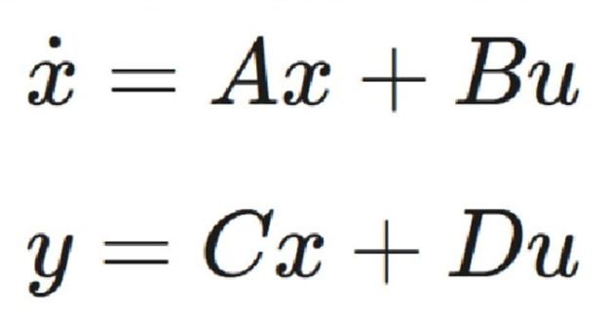
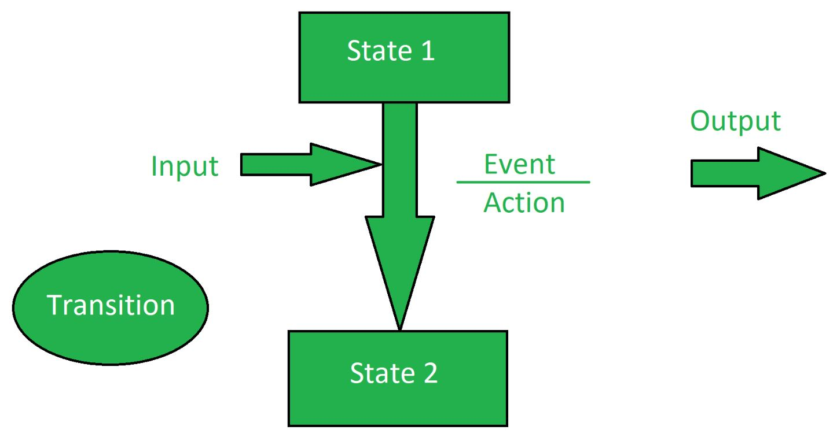
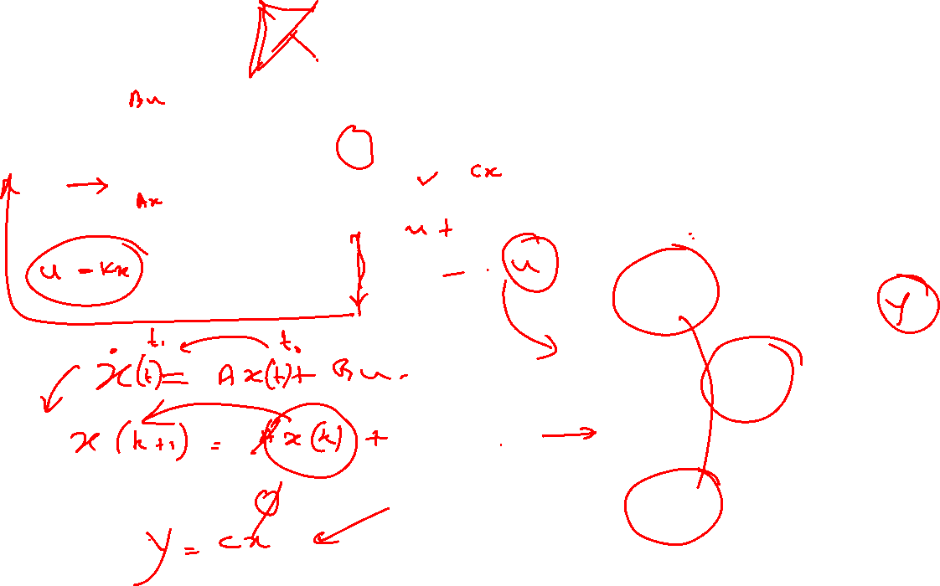
State Transitions -- The Big Picture

Slide 3
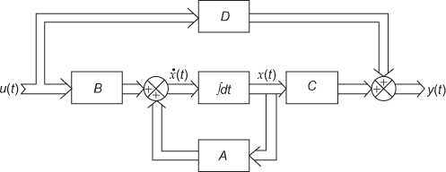
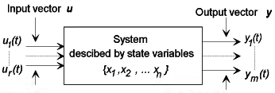
Multi Input Multi Output Systems
The State Space Equations

Slide 4

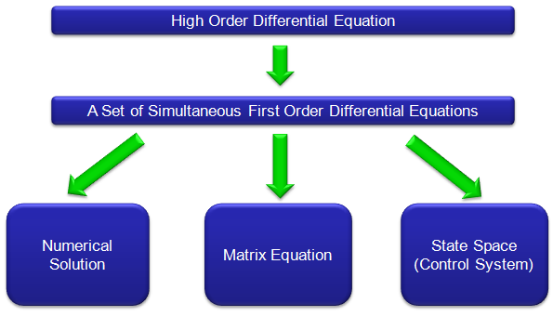
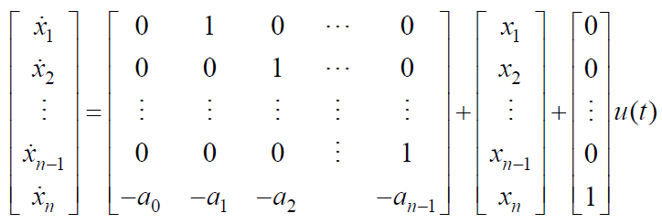

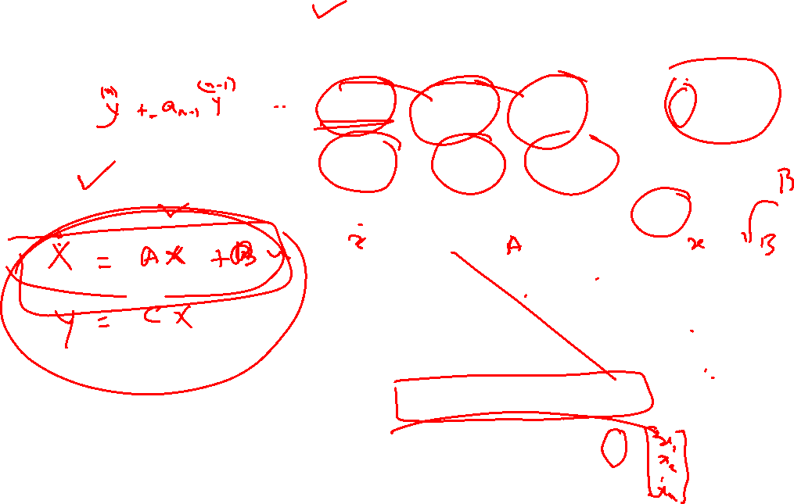
Selection of State Variables from an nth Order D.E.

Slide 5
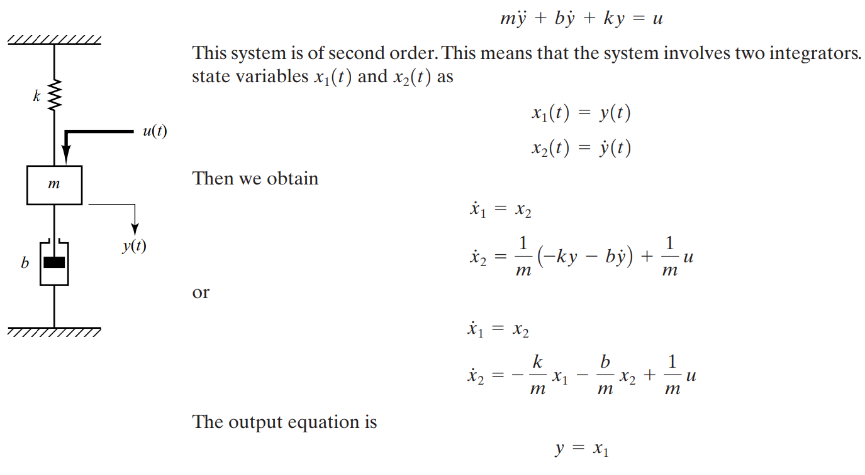
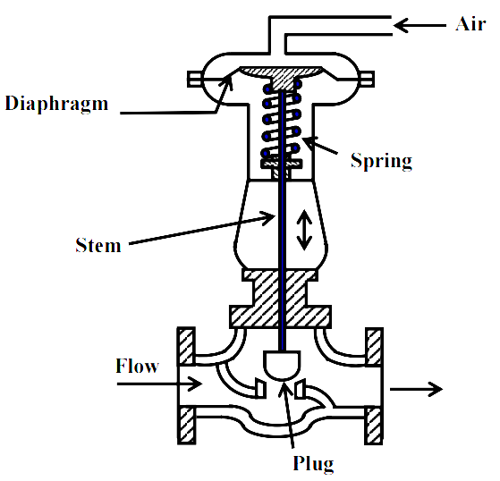

Formulating the State Space Equations
y is the linear travel/displacement

Slide 6
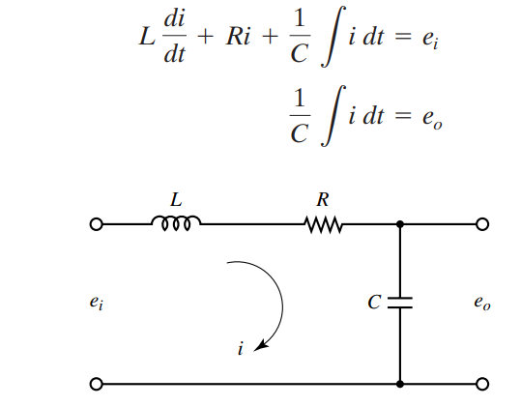
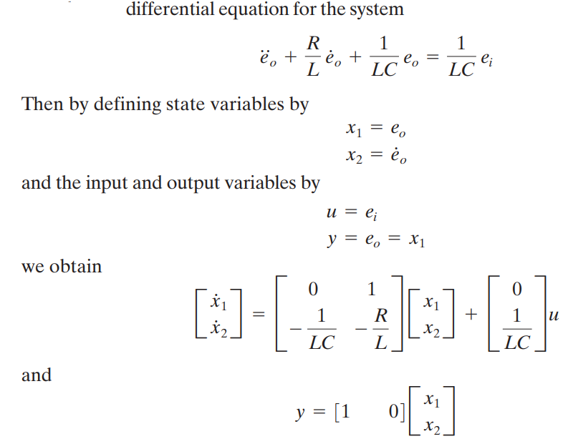

Formulating the State Space Equations

Slide 7
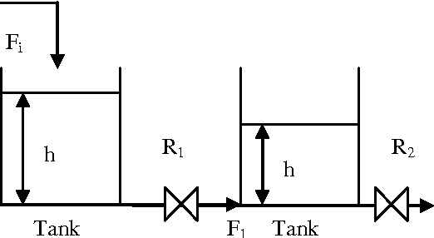
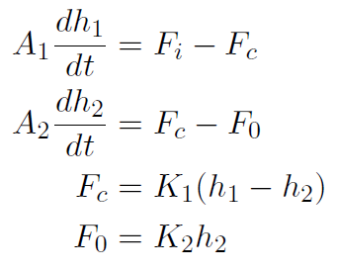
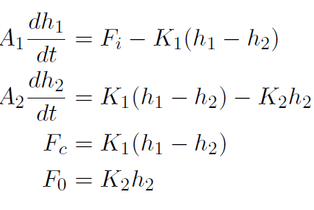
Formulating the State Space Equations

Slide 8



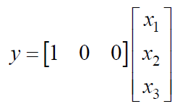
Eg. State Variables from D.E.

Slide 9


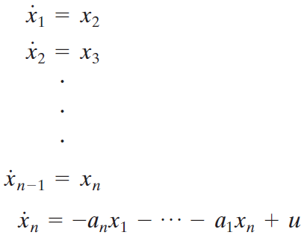
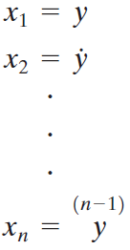

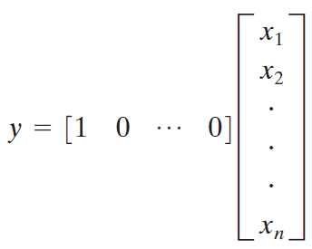


Transfer Function to State Space

Slide 10



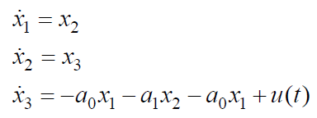




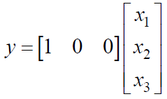

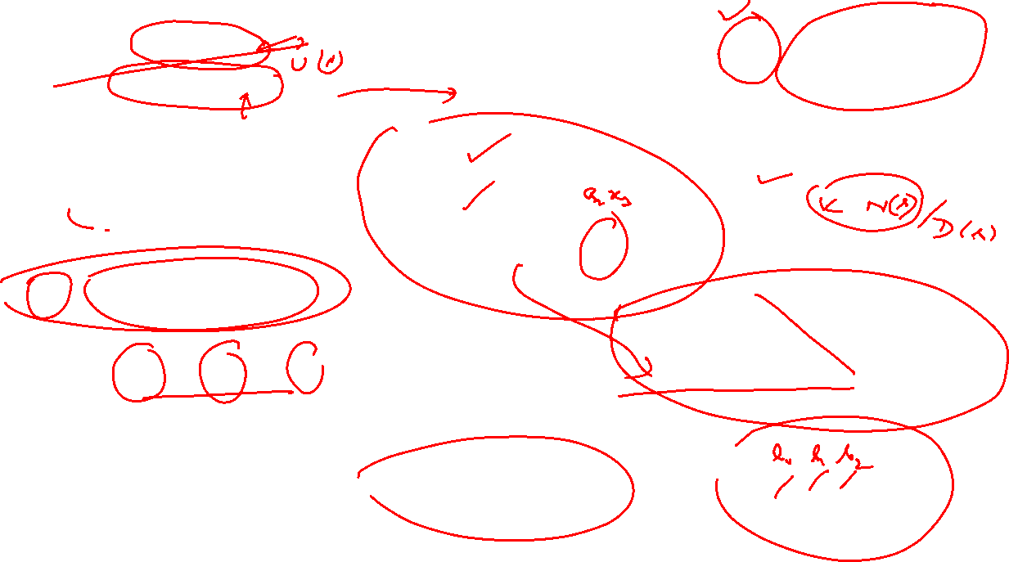
Transfer Functions with Numerator Dynamics

Slide 11




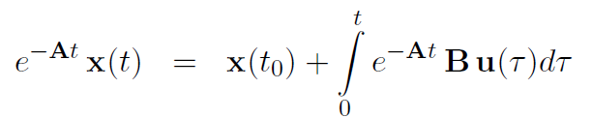
Solution of the State Equation

Slide 12





Solution of the State Equation by Laplace Transforms

Slide 13




Discretizing the State Equation

Slide 14
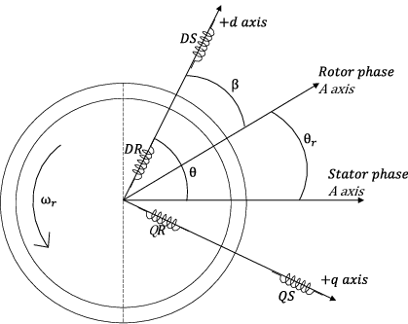
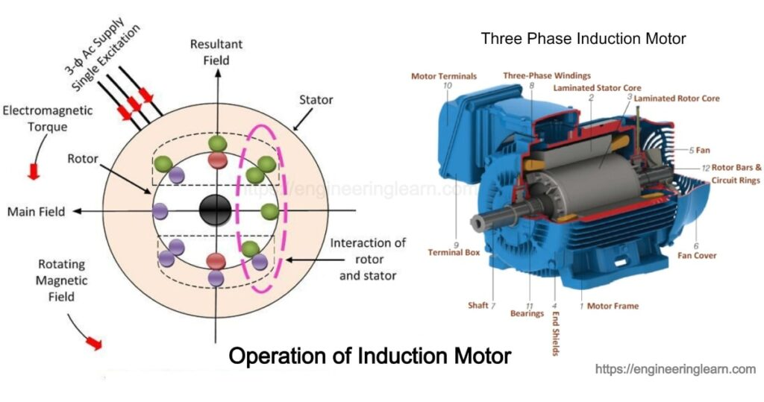
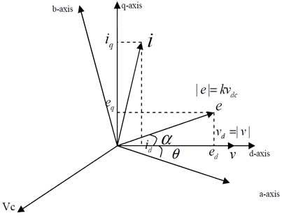
Induction Motor Model in Generalized D-Q Framework
The d axis, also known as the direct axis, is the axis by which flux is produced by the field winding.
The q axis, or the quadrature axis is the axis on which torque is produced.

Slide 15
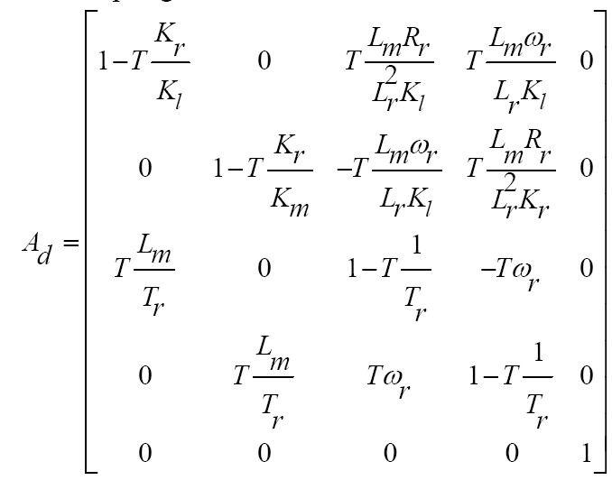
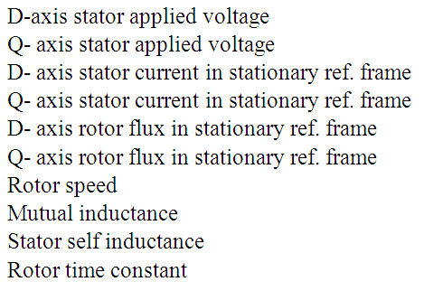
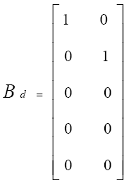
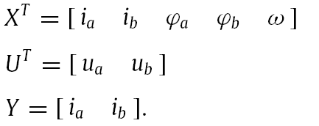
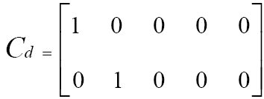

State Space Motor Model in Generalized D-Q Framework

Slide 16
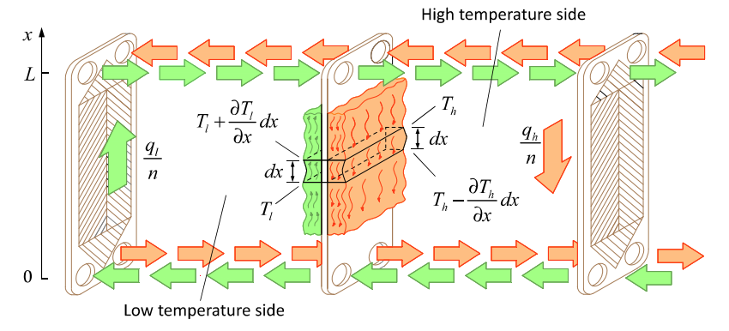
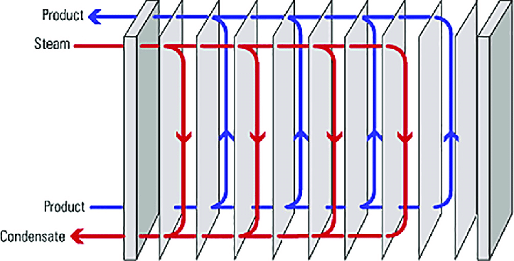
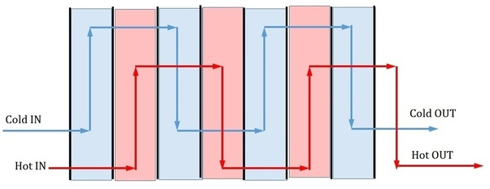
State Space Framework of the Plate type HEX
X = [T₁ T₂……T_{3N}]^{T}
U = [ dT_{chin} dT_{lin} dM_{che} dM_{lcwe} ]^{T}
Y = [dT_{lout}]
A = Transition matrix (3N x 3N)
B = Input matrix (3N x 4)
C = Output matrix (1 x 3N)
D= Feed forward matrix(1 x 4)
N is given as input parameter

